Slide 1
Agile Presentation
Kenneth Wilkerson
April 23, 2023

Slide 2

Roles in a Scrum-Agile Team

Slide 3

Product Owner
Serves as the “voice” of the customer
Establishes product requirements for the Developers
Primary responsibility is to create user stories and product backlog
Communicates with stakeholders
Attend Sprint Retrospective

Slide 4
Scrum Master
Coach and facilitator of team
Keeps team focused on essential elements of the project
Connects product management and development
Attends Daily Scrum when necessary
Helps address obstacles that team may face
Attend Sprint Retrospective

Slide 5
Tester
Creating test cases with clear pass or fail conditions
Providing feedback on test status
Support test driven development
Quality oriented thinker
Adapt to changing requirements
Attend Sprint Retrospective

Slide 6
Developer
Attend Daily Scrum meetings
Having a clear understanding of requirements established by the Product Owner
Using estimation strategies to allocate time to complete user stories in the sprint backlog
Developing the product requested by the client
Update progress charts
Attend Sprint Retrospective

Slide 7
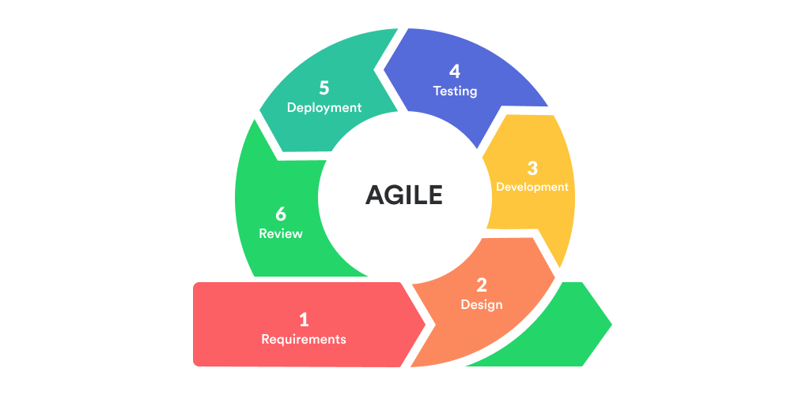
Phases of SDLC

Slide 8
1) Requirements: gathering and analyzing requirements derived from the customer
2) Design: Assess and choose the appropriate architectural design of the project
3) Development: implement software designs and source code
4) Testing: searches for missing or incomplete elements of the developers code
5) Deployment: project is released once all of the necessary testing and modifications are complete
6) Review: involves constant maintenance through out the projects lifecycle

Slide 9
Waterfall Approach
Product would fail to meet end-user’s needs: would end up with a top destination list instead of a top wellness and detox destination slide show.
New requirements would not be added: requirements would be established in the beginning with no input from the customer.
Higher priority would be placed on business contracts over the customer.
Testing would come after the project is completed which is very dangerous because there could be significant problems that lead to delays and going over budget.

Slide 10
Factors to be considered:
Agile vs Waterfall
What is the nature of the project? Is it linear or is it more unpredictable? In software development the nature of the requirements often change and needs a methodology to support that.
Is it a small project or a large project? A small project might have a clear end goal and could utilize either methodology. On the other hand, a large project may be difficult to have everything planned out up front and needs a more adaptive approach.
How fast is the project needed? A waterfall approach may take a lot more time than Agile. Agile is able to quickly release products that a customer may need.
What is the skill set of the team? Waterfall roles are one dimensional while Agile roles are more of a jack-of-all-trades style. Agile makes better use of team members skills and qualifications and they are involved throughout instead of waiting their turn in a waterfall system.

Slide 11
Resources
4 key responsibilities of outstanding scrum masters. ProductPlan. (2022, January 13). Retrieved April 23, 2023, from https://www.productplan.com/learn/scrum-master-responsibilities/
Anurina, O. (2019, May 10). Agile SDLC: How your project can benefit from this model. Agile SDLC: How Your Project Can Benefit From This Model. Retrieved April 23, 2023, from https://mlsdev.com/blog/agile-sdlc
Moore, T. (2022, April 20). The role and skills of a tester in an agile team. Experimentus. Retrieved April 23, 2023, from https://www.experimentus.com/blog/the-role-and-skills-of-a-tester-in-an-agile-team/
The Pros and cons of waterfall methodology. Lucidchart. (2018, August 10). Retrieved April 23, 2023, from https://www.lucidchart.com/blog/pros-and-cons-of-waterfall-methodology
Who is the scrum developer: Role and Responsibilities - QRP International. Belgium. (2021, February 16). Retrieved April 23, 2023, from https://www.qrpinternational.be/blog/glossary/who-is-the-scrum-developer-role-and-responsabilities/

